Slide 1
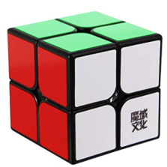
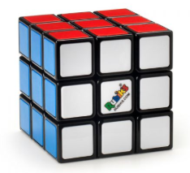
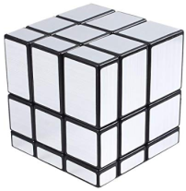
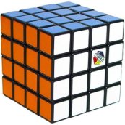
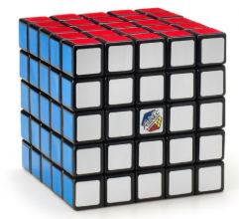
Recreational activity Unveils your Brains Interest Keeping you engaged
Entertainment Excitement Engagement
Rubik’s cube
Is it for Entertainment? Re creation? Relaxing? Rest?
Don’t worry it is for all of that.
For Young and old
Carry it
Anytime
Anywhere
Any bag
... with ease
Increase your IQ and Logical reasoning
Overcome your boredom ...
Add-ins
Helps you with finger movements.
Improves your reflexes
Facilitates quick decisions
Promotes speedy actions
Place order @ https://vcubes.com
Contact 9988007766
vcubes@gmail.com
Enhance your skills and solve ’em all .

